Slide 1


Slide 2

“One Another” Ministry When We Cannot Meet Together
Pastor Tom Sugimura

Slide 3

What Did We Learn From Covid-19?
The loneliness of being homebound
The losses of unmet expectations
The lascivious nature of temptation
The lovelessness of bitter conflicts

Slide 4
What Did We Learn From Covid-19?
The limitations of “online” church
The lukewarm condition of our faith
The languishing of chronic illness
The lament of grieving loved ones

Slide 5
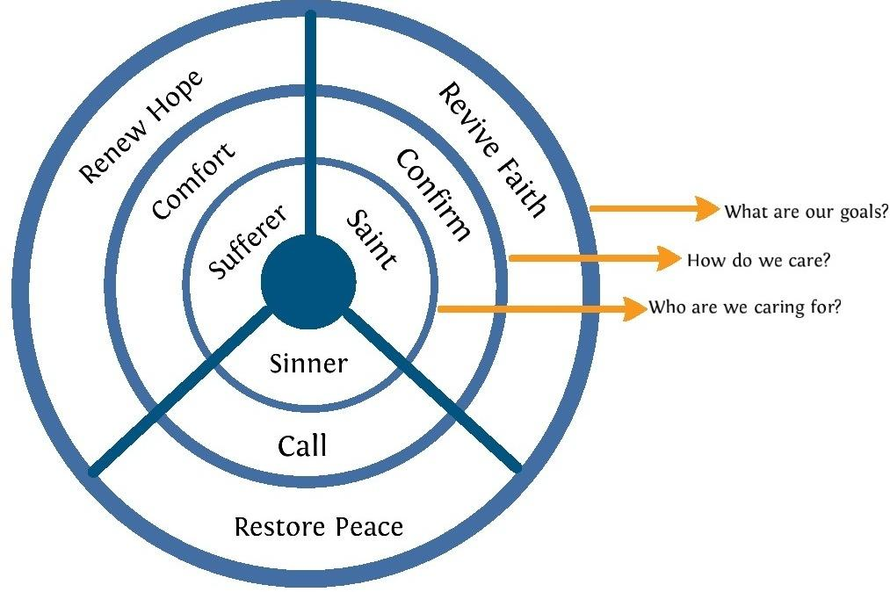
Who Still Hurts in Our Fallen World?

Slide 6
How Then Must the Church Respond?
Reflect our Creator’s glory (Genesis 1:26-28)
Reach the lost for Christ (Matthew 5:16; Acts 1:8)
Reciprocate the “One Anothers” (John 13:34-35)
Reveal the gospel’s power (Ephesians 4:1-3)
Rejoice for all eternity (Revelation 21:1-5)

Slide 7

“One Another” Ministry for the Homebound
Love with brotherly affection (Rom 12:10a)
Outdo in showing honor (Rom 12:10b)
Welcome one another (Rom 15:7)
Counsel one another (Rom 15:14)
Care for one another (Rom 12:5)
Notes:
Rom 12:10a Love one another with brotherly affection.
Rom 12:10b Outdo one another in showing honor.
Rom 15:7 Therefore welcome one another as Christ has welcomed you, for the glory of God.
Rom 15:14 I myself am satisfied about you, my brothers, that you yourselves are full of goodness, filled with all knowledge and able to instruct one another.
Rom 12:5 so we, though many, are one body in Christ, and individually members one of another.

Slide 8
“One Another” Ministry for the Homebound
Shoulder one another’s burdens (Gal 6:2)
Speak the truth in love (Eph 4:25)
Exhort one another with singing (Col 3:16)
Comfort one another (1 Thess 4:18)
Pray for one another (1 Tim 2:1)
Notes:
Gal 6:2 Bear one another's burdens, and so fulfill the law of Christ.
Eph 4:25 Therefore, having put away falsehood, let each one of you speak the truth with his neighbor, for we are members one of another.
Col 3:16 Let the word of Christ dwell in you richly, teaching and admonishing one another in all wisdom, singing psalms and hymns and spiritual songs, with thankfulness in your hearts to God.
1 Thess 4:18 Therefore encourage one another with these words.
1 Tim 2:1 First of all, then, I urge that supplications, prayers, intercessions, and thanksgivings be made for all people.

Slide 9
“One Another” Ministry for the Homebound
Be hospitable to one another (1 Pet 4:9)
Serve one another (1 Pet 4:10)
Greet one another with a kiss (1 Pet 5:14)
Consider one another (Phil 2:3)
Fellowship with one another (1 John 1:7)
Notes:
1 Peter 4:9 Show hospitality to one another without grumbling.
1 Peter 4:10 As each has received a gift, use it to serve one another, as good stewards of God's varied grace:
1 Peter 5:14 Greet one another with the kiss of love. Peace to all of you who are in Christ.
Phil 2:3 Do nothing from selfish ambition or conceit, but in humility count others more significant than yourselves.
1 John 1:7 But if we walk in the light, as he is in the light, we have fellowship with one another, and the blood of Jesus his Son cleanses us from all sin.

